Slide 1
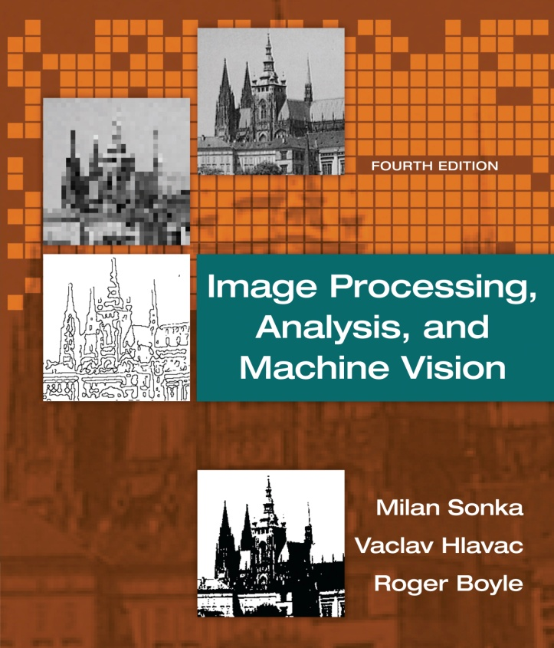

Chapter 5
Image Processing, Analysis, and Machine Vision, 4th Edition Sonka, Hlavac & Boyle
Image pre-processing

Slide 2
Image pre-processing
Image Processing, Analysis, and Machine Vision, 4th Edition Sonka, Hlavac & Boyle
Pixel brightness transformations
Geometric transformations
Local pre-processing
Image smoothing, edge detection, line detection, corner detection, and region detection.
Image restoration

Slide 3
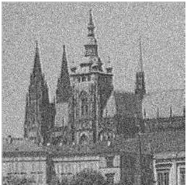
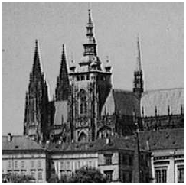
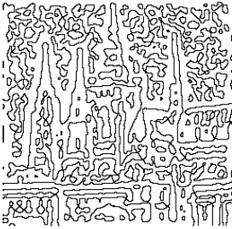
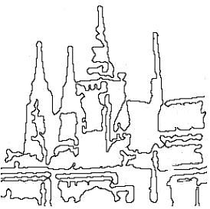
Objectives of image pre-processing
(a) Enhancing information that is useful for later
analysis
(b) Suppress image information that is not relevant
to later work

Slide 4
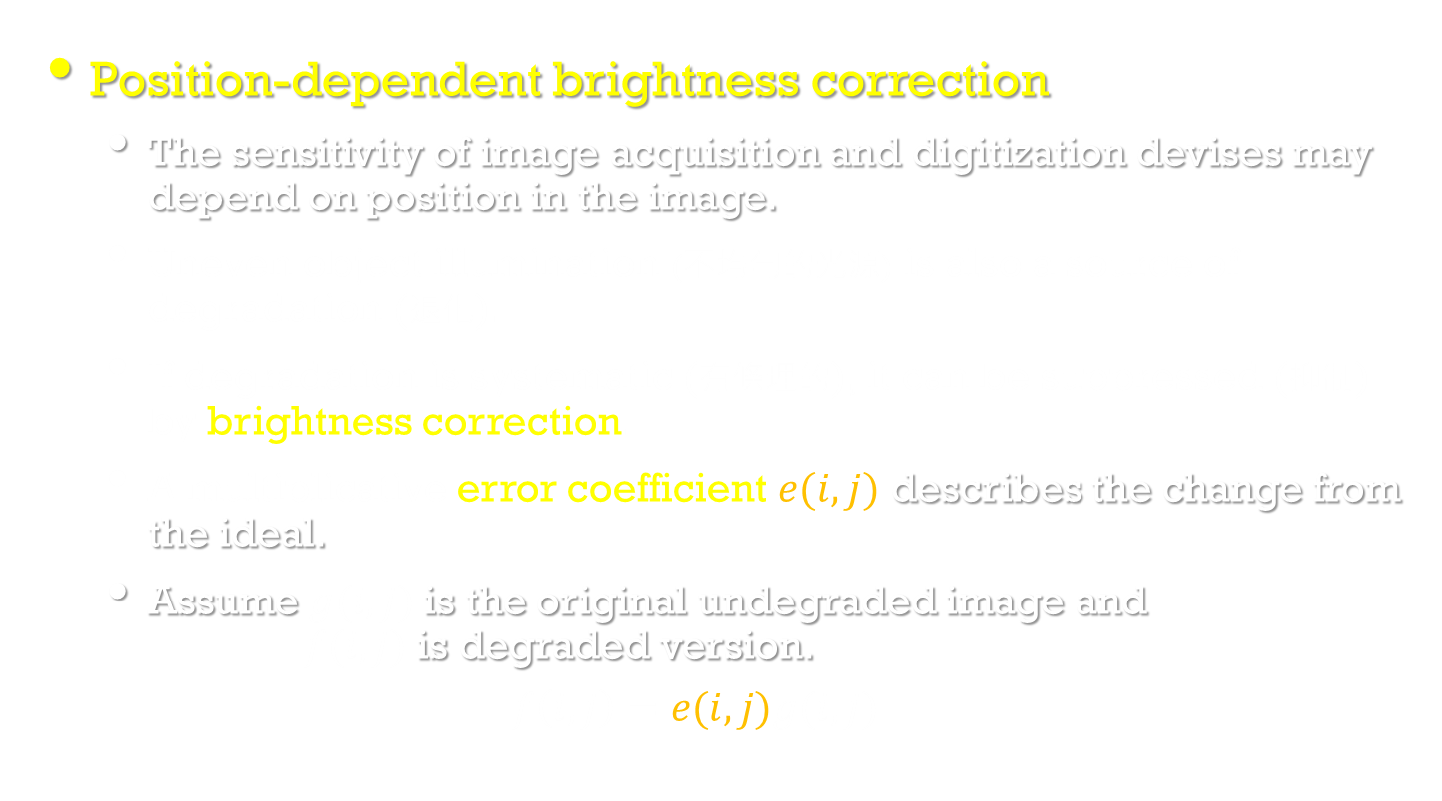
Pixel brightness transformations
Image Processing, Analysis, and Machine Vision, 4th Edition Sonka, Hlavac & Boyle
Position-dependent brightness correction
The sensitivity of image acquisition and digitization devises may depend on position in the image.
Uneven object illumination (不均勻的光源) is also a source of degradation (退化).
If degradation is systematic (有條理的), it can be suppressed (抑制) by brightness correction.
A multiplicative error coefficient $e(i,j)$ describes the change from the ideal.
Assume $g(i,j)$is the original undegraded image and $f(i,j)$is degraded version.
$$f\left(i,j\right)=e(i,j)g(i,j)$$

Slide 5
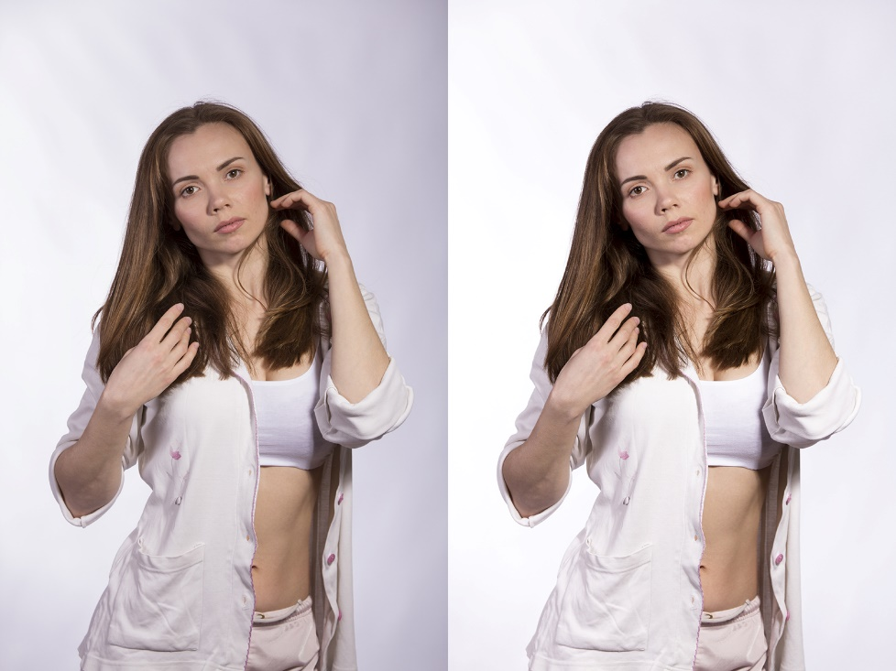
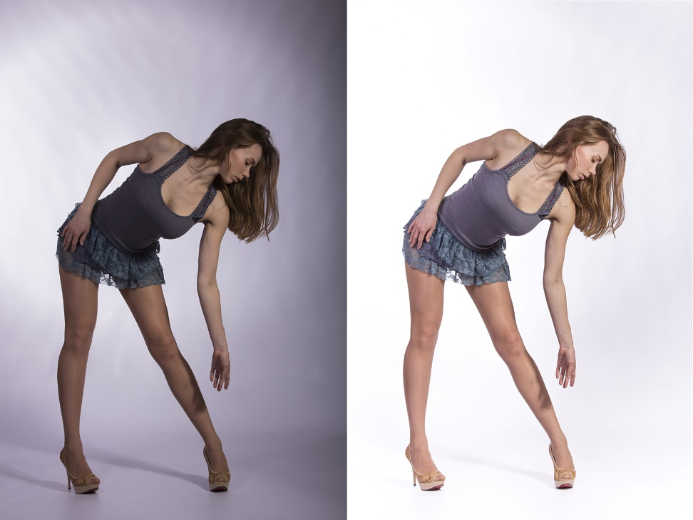
Examples
http://portfolio.veronika-by.com.ua/raw-to-jpeg-with-brigthness-correction/

Slide 6
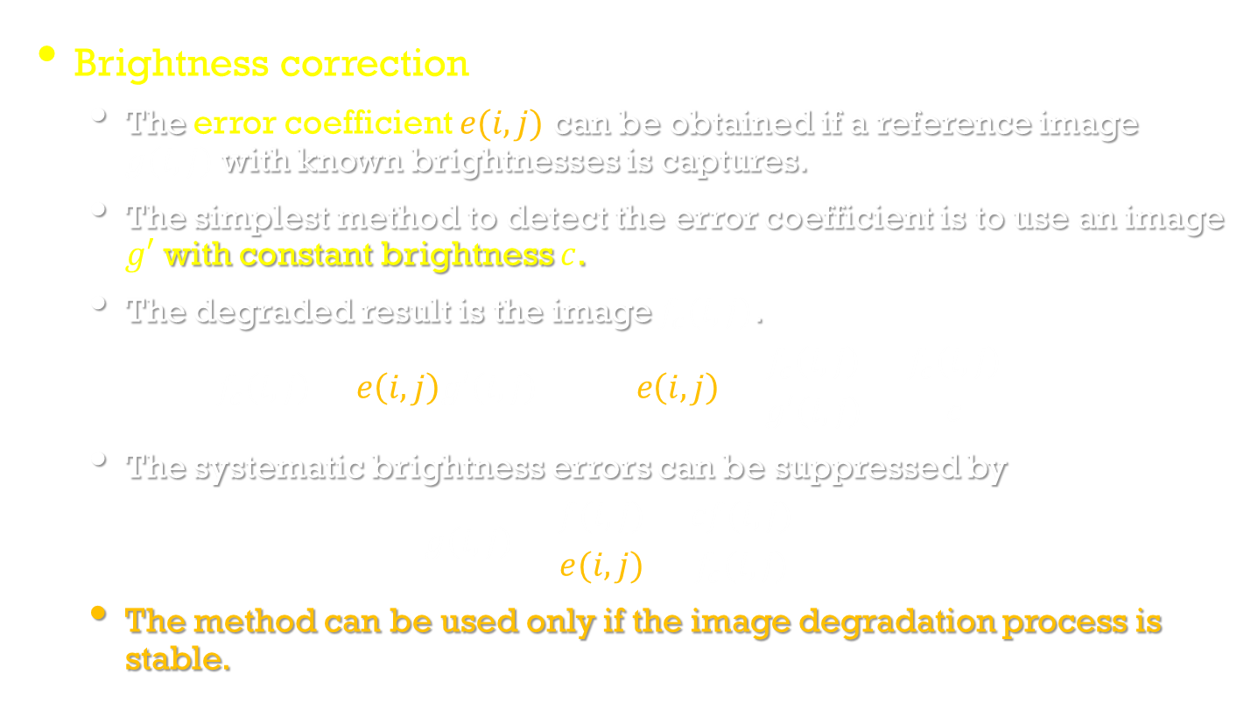
Pixel brightness transformations
Image Processing, Analysis, and Machine Vision, 4th Edition Sonka, Hlavac & Boyle
Brightness correction
The error coefficient $e(i,j)$ can be obtained if a reference image $g(i,j)$with known brightnesses is captures.
The simplest method to detect the error coefficient is to use an image $g′$ with constant brightness $c$.
The degraded result is the image $f_{c}(i,j)$.
$$f_{c}\left(i,j\right)=e\left(i,j\right)g′\left(i,j\right) e\left(i,j\right)=\frac{f_{c}\left(i,j\right)}{g′\left(i,j\right)}=\frac{f_{c}\left(i,j\right)}{c}$$
The systematic brightness errors can be suppressed by
$$g\left(i,j\right)=\frac{f(i,j)}{e(i,j)}=\frac{cf(i,j)}{f_{c}(i,j)}$$
The method can be used only if the image degradation process is stable.

Slide 7
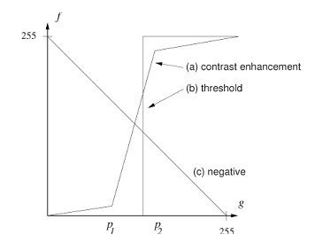
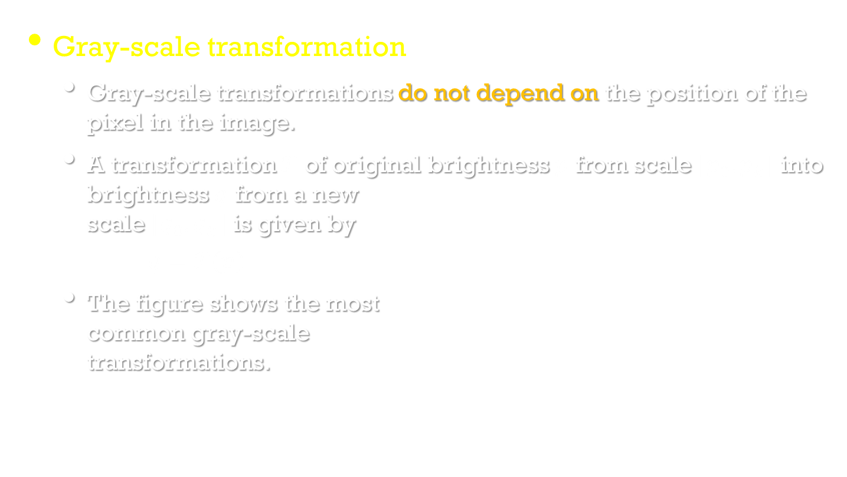
Pixel brightness transformations
Image Processing, Analysis, and Machine Vision, 4th Edition Sonka, Hlavac & Boyle
Gray-scale transformation
Gray-scale transformations do not depend on the position of the pixel in the image.
A transformation $𝒯$ of original brightness $p$ from scale $[p_{0},p_{k}]$ into brightness $q$ from a new scale $[q_{0},q_{k}]$ is given by
$$q=𝒯(p)$$
The figure shows the most common gray-scale transformations.

Slide 8
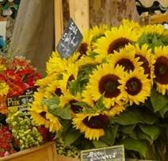
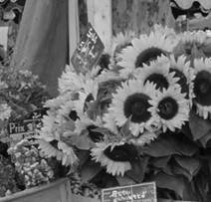
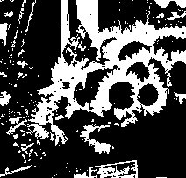
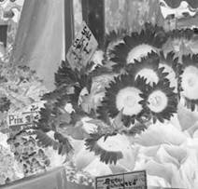
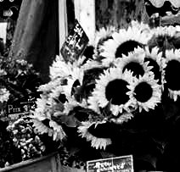

Slide 9
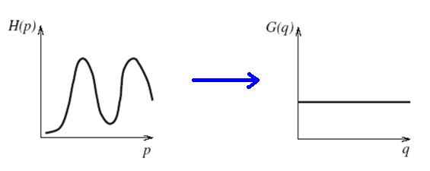
Gray-scale transformation
Image Processing, Analysis, and Machine Vision, 4th Edition Sonka, Hlavac & Boyle
Histogram equalization
The aim is to create an image with equally distributed brightness levels over the whole brightness scale.
Histogram equalization enhances contrast for brightness values close to histogram maxima, and decreases contrast near minima.

Slide 10
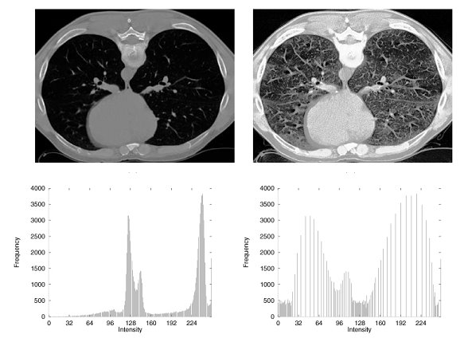
Histogram equalization
Image Processing, Analysis, and Machine Vision, 4th Edition Sonka, Hlavac & Boyle

Slide 11
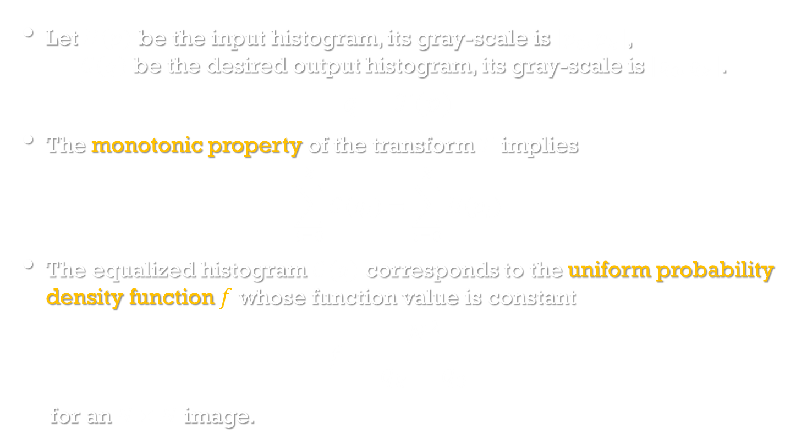
Histogram equalization
Image Processing, Analysis, and Machine Vision, 4th Edition Sonka, Hlavac & Boyle
Let $H(p)$ be the input histogram, its gray-scale is $[p_{0},p_{k}]$, $G(q)$ be the desired output histogram, its gray-scale is $[q_{0},q_{k}]$.
$$q=𝒯(p)$$
The monotonic property of the transform $𝒯$implies
$$\sum_{i=0}^{k}{G(q_{i})}=\sum_{i=0}^{k}{H(p_{i})}$$
The equalized histogram $G(q)$ corresponds to the uniform probability density function $f$ whose function value is constant
$$f=\frac{N^{2}}{q_{k}−q_{0}}$$
for an $N×N$ image.

Slide 12
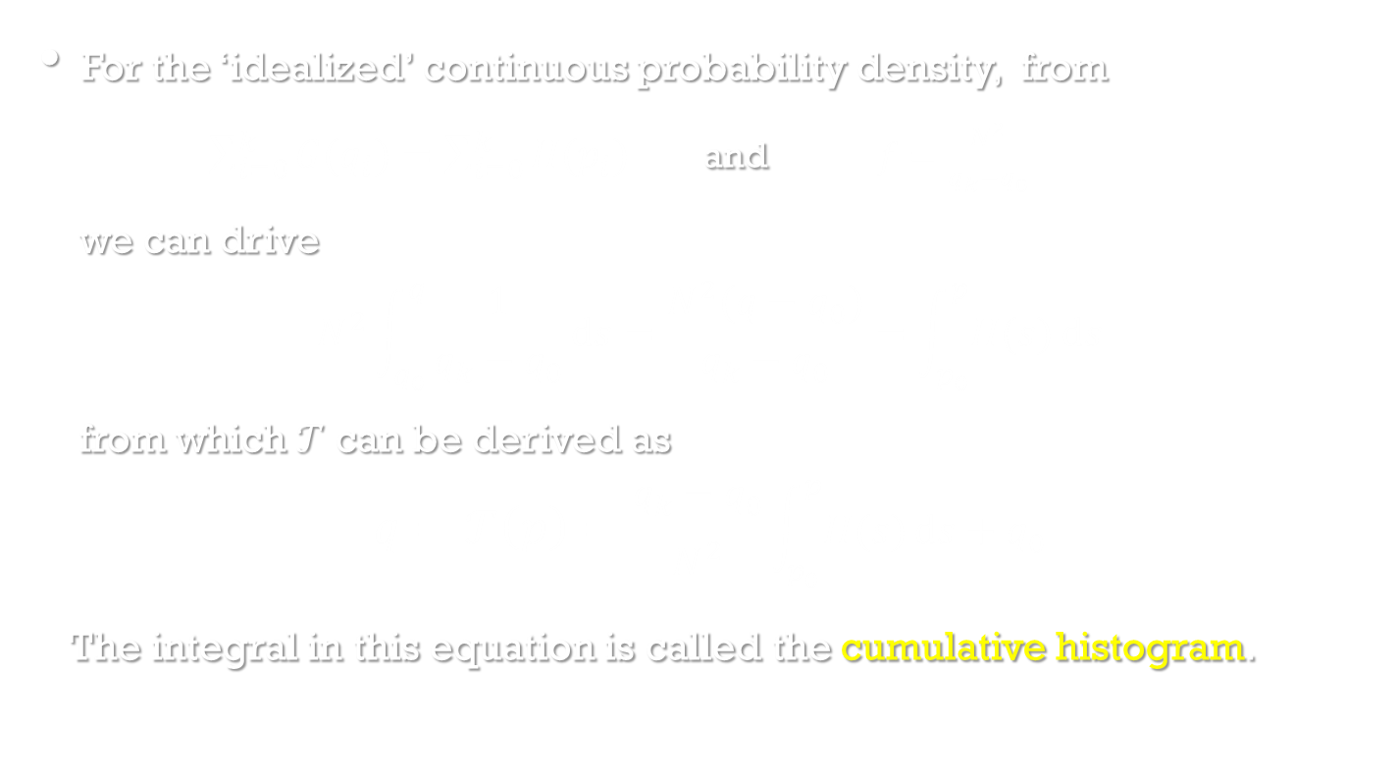
Histogram equalization
Image Processing, Analysis, and Machine Vision, 4th Edition Sonka, Hlavac & Boyle
For the ‘idealized’ continuous probability density, from
$\sum_{i=0}^{k}{G(q_{i})}=\sum_{i=0}^{k}{H(p_{i})}$ and $f=\frac{N^{2}}{q_{k}−q_{0}}$
we can drive
$$N^{2}\int_{q_{0}}^{q}{\frac{1}{q_{k}−q_{0}}}ds=\frac{N^{2}(q−q_{0})}{q_{k}−q_{0}}=\int_{p_{0}}^{p}{H(s)}ds$$
from which $𝒯$ can be derived as
$$q=𝒯\left(p\right)=\frac{q_{k}−q_{0}}{N^{2}}\int_{p_{0}}^{p}{H(s)}ds+q_{0}$$
The integral in this equation is called the cumulative histogram.

Slide 13
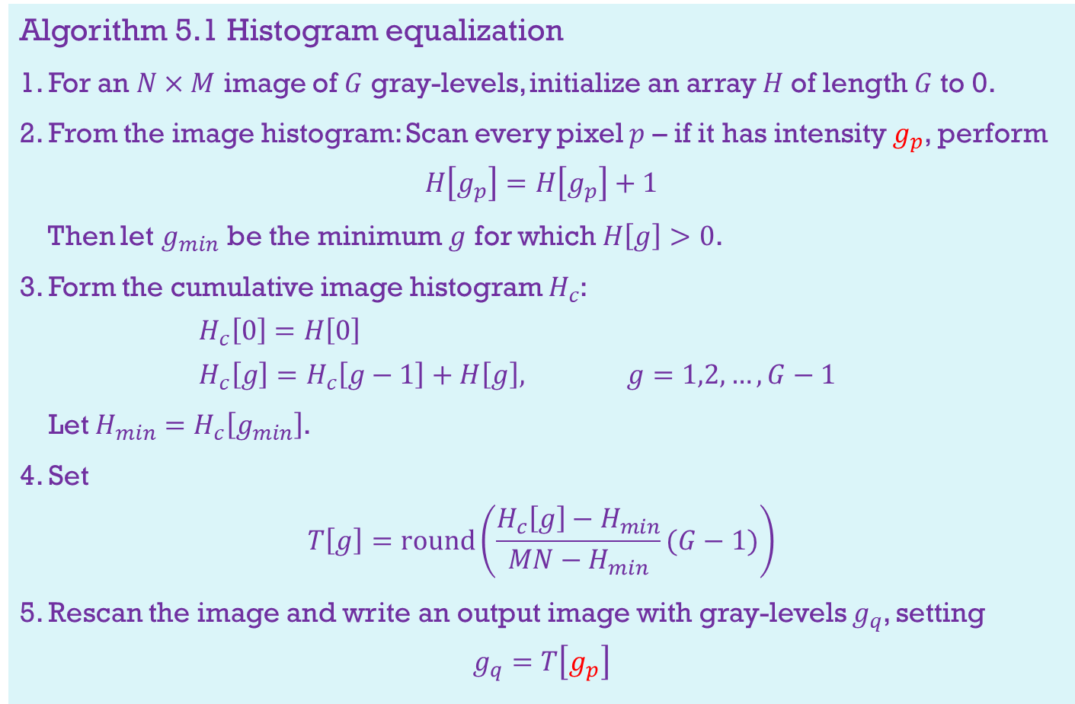
Algorithm 5.1 Histogram equalization
1. For an $N×M$ image of $G$ gray-levels, initialize an array $H$of length $G$to 0.
2. From the image histogram: Scan every pixel $p$ – if it has intensity $g_{p}$, perform
$$H\left[g_{p}\right]=H\left[g_{p}\right]+1$$
Then let $g_{min}$ be the minimum $g$ for which $H\left[g\right]>0$.
3. Form the cumulative image histogram $H_{c}$:
$$H_{c}\left[0\right]=H\left[0\right]$$
$$H_{c}\left[g\right]=H_{c}\left[g−1\right]+H\left[g\right], g=1,2,…,G−1$$
Let $H_{min}=H_{c}\left[g_{min}\right]$.
4. Set
$$T\left[g\right]=round\left(\frac{H_{c}\left[g\right]−H_{min}}{MN−H_{min}}(G−1)\right)$$
5. Rescan the image and write an output image with gray-levels $g_{q}$, setting
$$g_{q}=T\left[g_{p}\right]$$

Slide 14
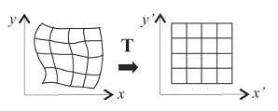
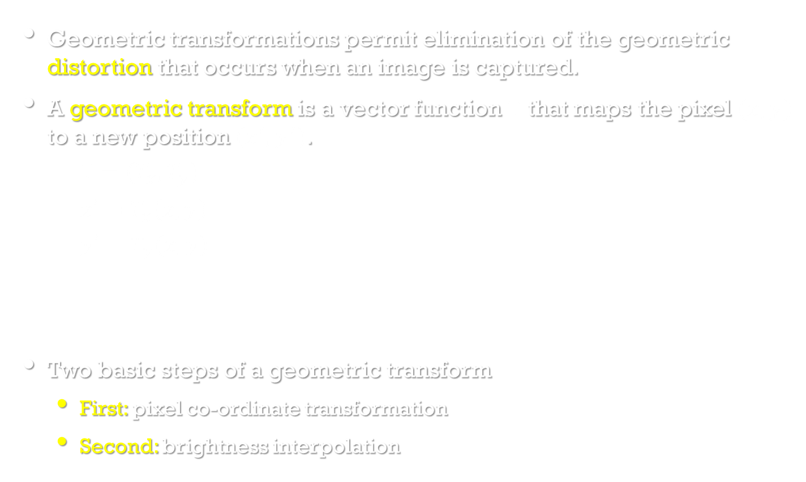
Geometric transformations
Image Processing, Analysis, and Machine Vision, 4th Edition Sonka, Hlavac & Boyle
Geometric transformations permit elimination of the geometric distortion that occurs when an image is captured.
A geometric transform is a vector function $T$ that maps the pixel $(x,y)$ to a new position $(x^{′},y^{′})$.
$$T=(T_{x},T_{y})$$
$$x′=T_{x}\left(x,y\right)$$
$$y′=T_{y}(x,y)$$
Two basic steps of a geometric transform
First: pixel co-ordinate transformation
Second: brightness interpolation

Slide 15
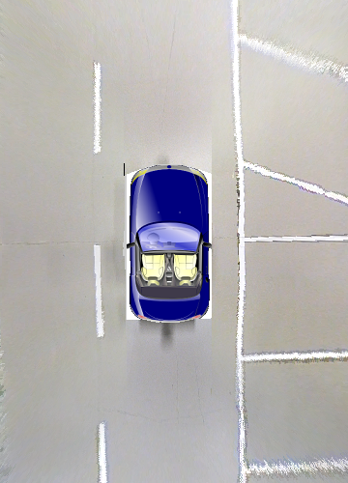
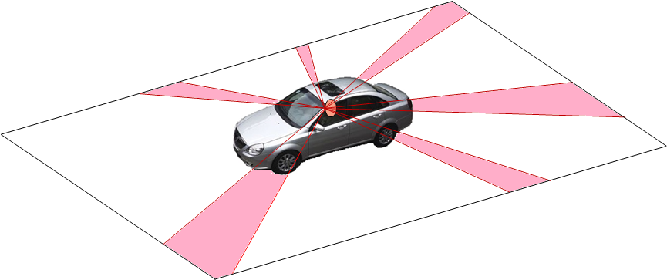
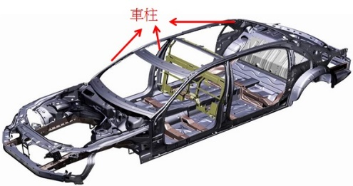
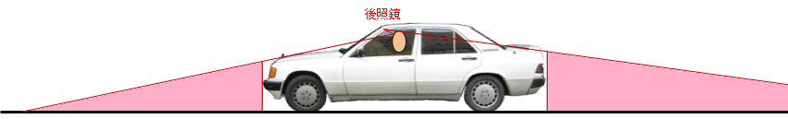
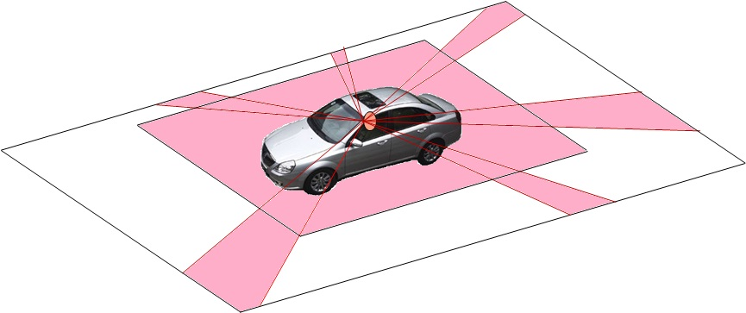
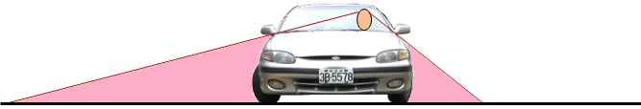
Application: Bird’s-View Image Generation
Blind areas around a vehicle
Window pillars
Height of vehicle
Summary of blind areas
Driver’s position

Slide 16
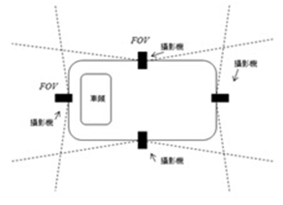
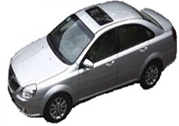
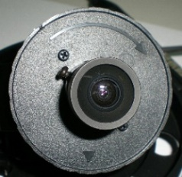
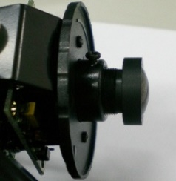
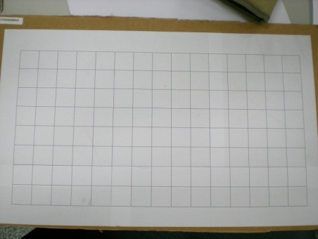
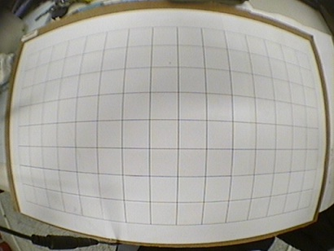
System Configuration
Fish-eye camera:
Scene
Image
5-16

Slide 17
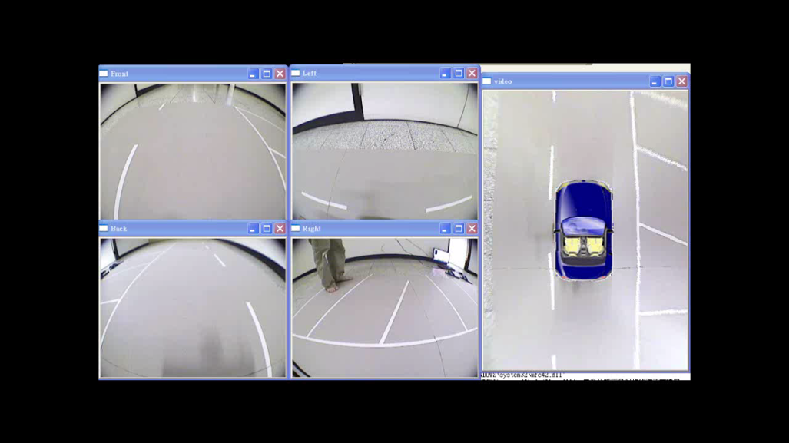
5-17

Slide 18
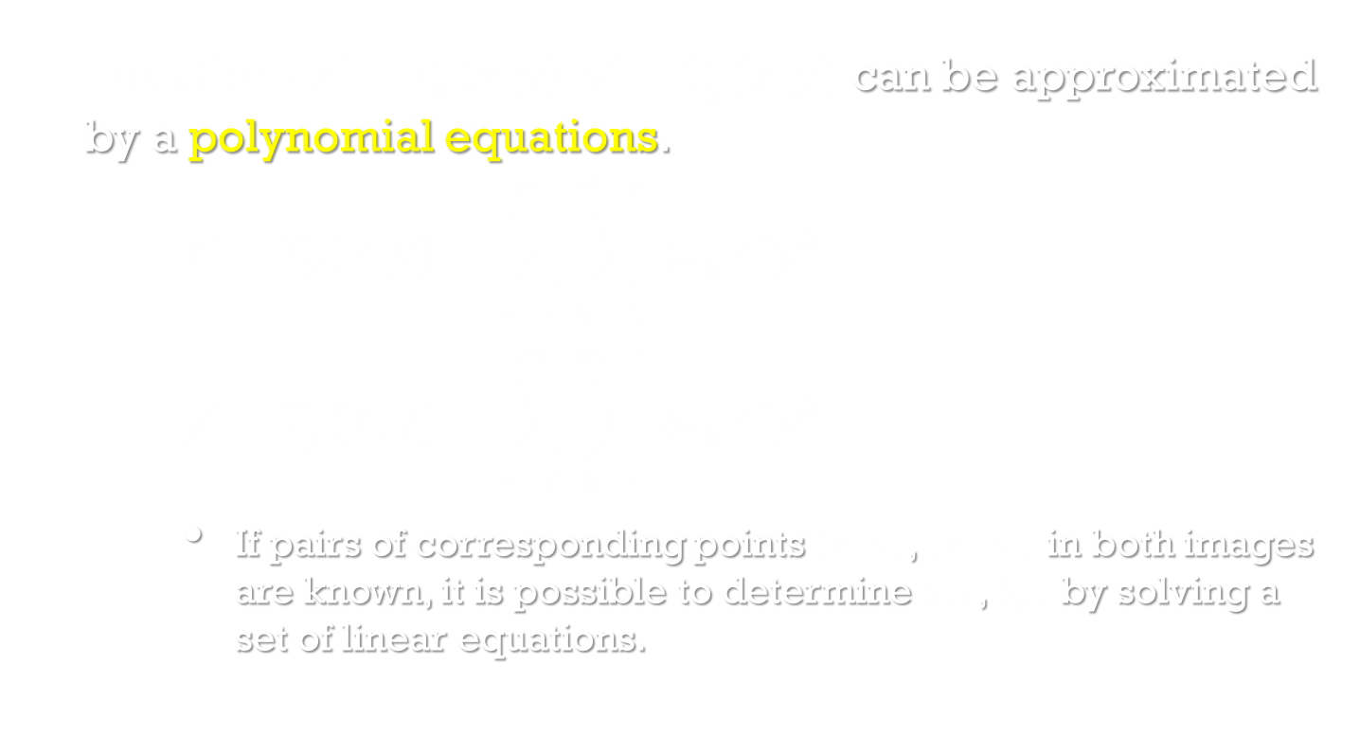
Pixel co-ordinate transformation
Image Processing, Analysis, and Machine Vision, 4th Edition Sonka, Hlavac & Boyle
Equations $x′=T_{x}\left(x,y\right), y′=T_{y}(x,y)$ can be approximated by a polynomial equations.
$$x′=T_{x}\left(x,y\right)=\sum_{r=0}^{m}{\sum_{k=0}^{m−r}{a_{rk}x^{r}y^{k}}}$$
$$y′=T_{y}(x,y)=\sum_{r=0}^{m}{\sum_{k=0}^{m−r}{b_{rk}x^{r}y^{k}}}$$
If pairs of corresponding points $\left(x,y\right)$, $\left(x′,y′\right)$ in both images are known, it is possible to determine $a_{rk}$, $b_{rk}$ by solving a set of linear equations.

Slide 19
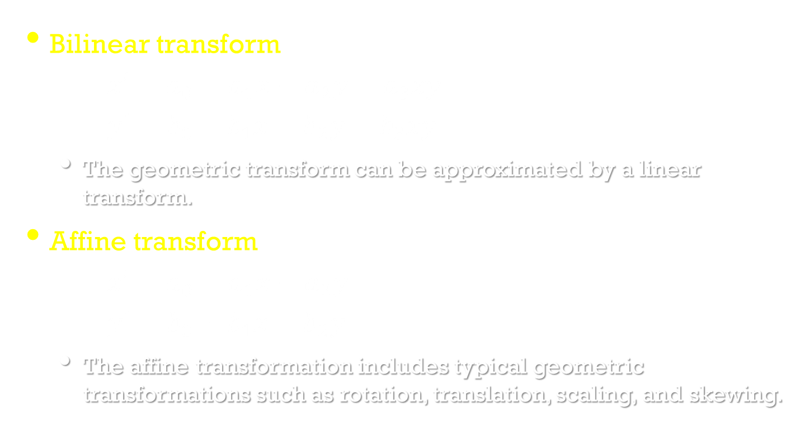
Pixel co-ordinate transformation
Image Processing, Analysis, and Machine Vision, 4th Edition Sonka, Hlavac & Boyle
Bilinear transform
$$x′=a_{0}+a_{1}x+a_{2}y+a_{3}xy$$
$$y′=b_{0}+b_{1}x+b_{2}y+b_{3}xy$$
The geometric transform can be approximated by a linear transform.
Affine transform
$$x′=a_{0}+a_{1}x+a_{2}y$$
$$y′=b_{0}+b_{1}x+b_{2}y$$
The affine transformation includes typical geometric transformations such as rotation, translation, scaling, and skewing.

Slide 20
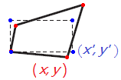
Example:
Bilinear transform
Needs at least 4 pairs of corresponding points to
determine the parameters

Slide 21
Solve x by the least square error method.

Slide 22
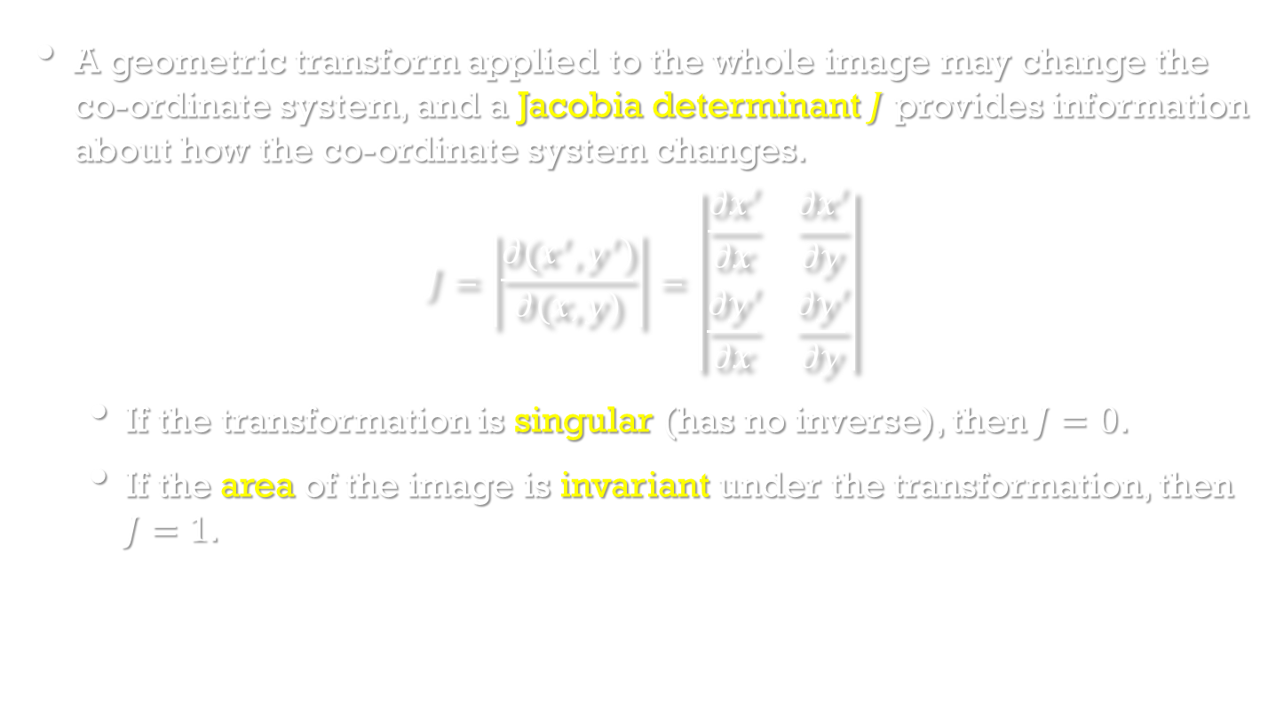
Pixel co-ordinate transformation
Image Processing, Analysis, and Machine Vision, 4th Edition Sonka, Hlavac & Boyle
A geometric transform applied to the whole image may change the co-ordinate system, and a Jacobia determinant $J$ provides information about how the co-ordinate system changes.
$$J=\left|\frac{∂(x^{′},y^{′})}{∂(x,y)}\right|=\left|\begin{matrix}\frac{∂x′}{∂x} & \frac{∂x′}{∂y} \\ \frac{∂y′}{∂x} & \frac{∂y′}{∂y}\end{matrix}\right|$$
If the transformation is singular (has no inverse), then $J=0$.
If the area of the image is invariant under the transformation, then $J=1$.

Slide 23
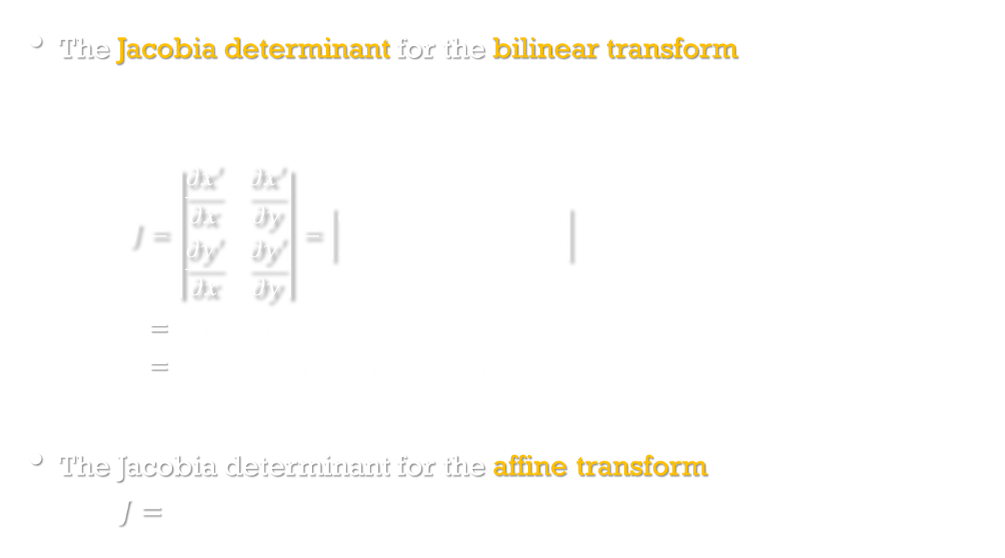
Pixel co-ordinate transformation
Image Processing, Analysis, and Machine Vision, 4th Edition Sonka, Hlavac & Boyle
The Jacobia determinant for the bilinear transform
$$x′=a_{0}+a_{1}x+a_{2}y+a_{3}xy$$
$$y^{′}=b_{0}+b_{1}x+b_{2}y+b_{3}xy$$
$$J=\left|\begin{matrix}\frac{∂x′}{∂x} & \frac{∂x′}{∂y} \\ \frac{∂y′}{∂x} & \frac{∂y′}{∂y}\end{matrix}\right|=\left|\begin{matrix}a_{1}+a_{3}y & a_{2}+a_{3}x \\ b_{1}+b_{3}y & b_{2}+b_{3}x\end{matrix}\right|$$
$$=\left(a_{1}+a_{3}y\right)\left(b_{2}+b_{3}x\right)−\left(b_{1}+b_{3}y\right)\left(a_{2}+a_{3}x\right)$$ $=a_{1}b_{2}−a_{2}b_{1}+\left(a_{1}b_{3}−a_{3}b_{1}\right)x+\left(a_{3}b_{2}−a_{2}b_{3}\right)y$
The Jacobia determinant for the affine transform
$$J=a_{1}b_{2}−a_{2}b_{1}$$

Slide 24
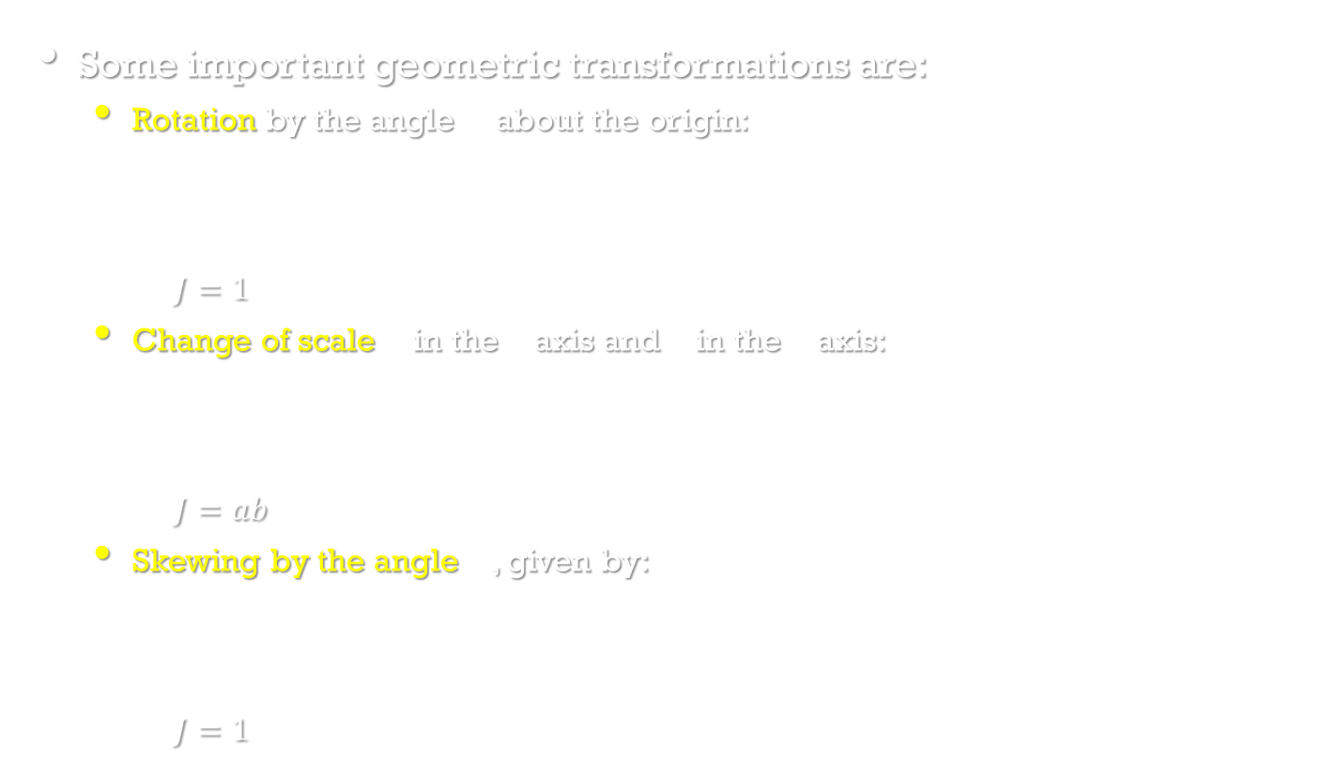
Pixel co-ordinate transformation
Image Processing, Analysis, and Machine Vision, 4th Edition Sonka, Hlavac & Boyle
Some important geometric transformations are:
Rotation by the angle $φ$ about the origin:
$x^{′}= xcosφ+y$sin$φ$
$$y^{′}=−xsinφ+y\text{cos}φ$$
$$J=1$$
Change of scale $a$ in the $x$ axis and $b$ in the $y$ axis:
$x^{′}=ax$
$$y^{′}=by$$
$$J=ab$$
Skewing by the angle $φ$, given by:
$x^{′}=x+ytanφ$
$$y^{′}=y$$
$$J=1$$

Slide 25
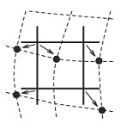
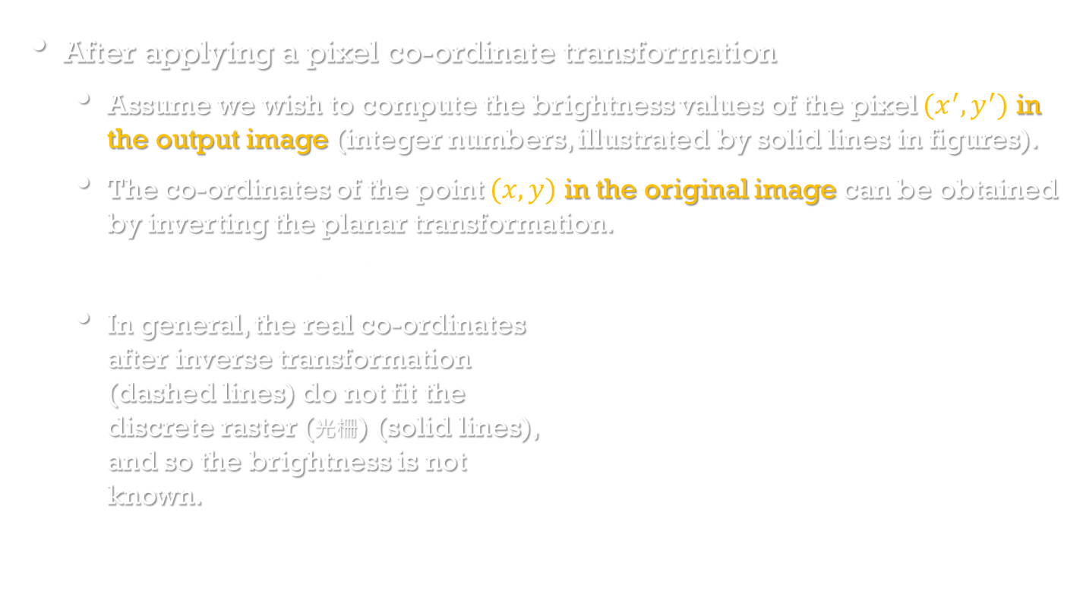
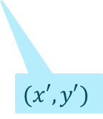
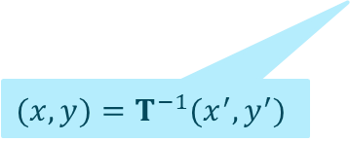
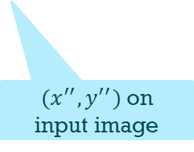
Brightness interpolation
Image Processing, Analysis, and Machine Vision, 4th Edition Sonka, Hlavac & Boyle
After applying a pixel co-ordinate transformation
Assume we wish to compute the brightness values of the pixel $(x^{′},y^{′})$ in the output image (integer numbers, illustrated by solid lines in figures).
The co-ordinates of the point $(x,y)$ in the original image can be obtained by inverting the planar transformation.
$\left(x,y\right)=T^{−1}(x^{′},y^{′})$
In general, the real co-ordinates after inverse transformation (dashed lines) do not fit the discrete raster (光柵) (solid lines), and so the brightness is not known.
Input image
Output image
$$(x,y)=T^{−1}(x^{′},y^{′})$$
$(x^{′′},y^{′′})$ on input image
$$(x′,y′)$$

Slide 26
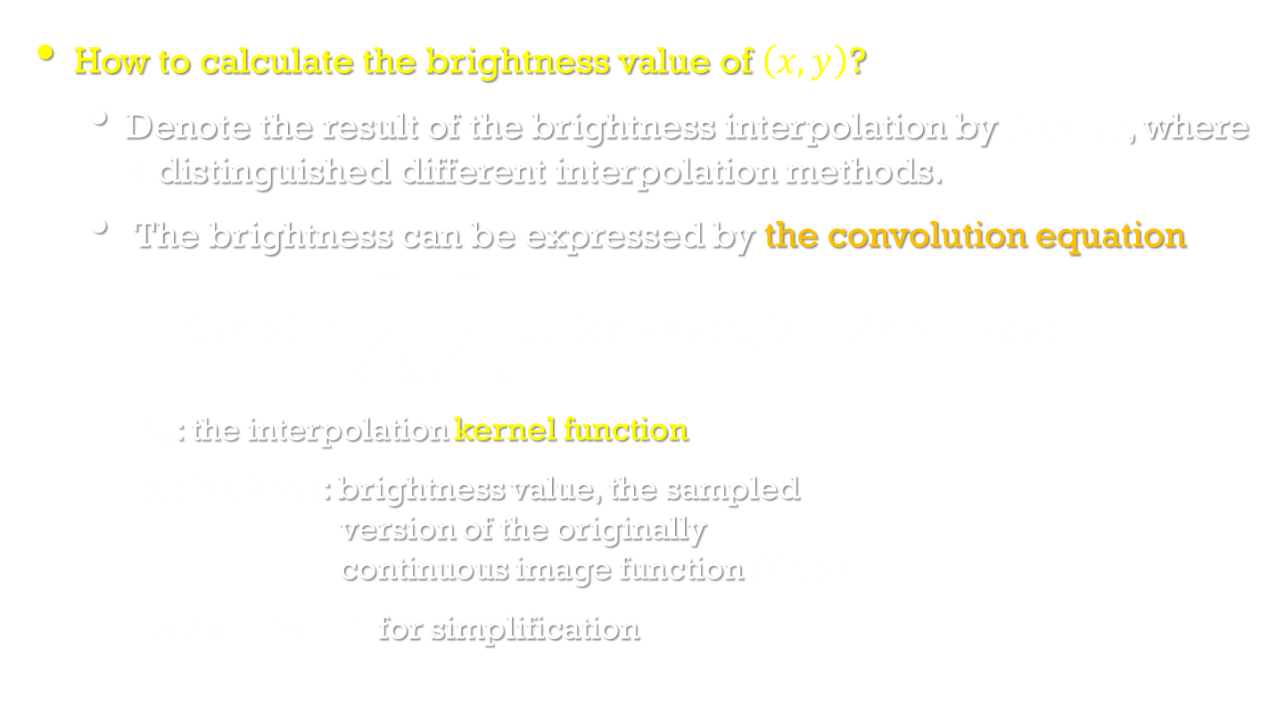
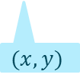
Brightness interpolation
Image Processing, Analysis, and Machine Vision, 4th Edition Sonka, Hlavac & Boyle
How to calculate the brightness value of $\left(x,y\right)$?
Denote the result of the brightness interpolation by $f_{n}\left(x,y\right)$, where $n$ distinguished different interpolation methods.
The brightness can be expressed by the convolution equation
$$f_{n}\left(x,y\right)=\sum_{l=−∞}^{∞}{\sum_{k=−∞}^{∞}{g_{s}(l∆x,k∆y})h_{n}(x−l∆x,y−k∆y)}$$
$h_{n}$: the interpolation kernel function
$g_{s}(l∆x,k∆y)$: brightness value, the sampled version of the originally continuous image function $f\left(x,y\right)$
let $∆x=∆y=1$ for simplification
Input image
Output image
$$(x,y)$$

Slide 27
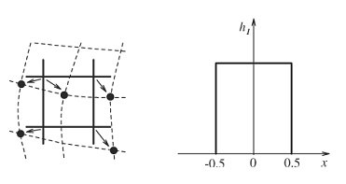

Brightness interpolation
Image Processing, Analysis, and Machine Vision, 4th Edition Sonka, Hlavac & Boyle
Three most common brightness interpolation methods are nearest neighbor, linear and bi-cubic.
Nearest-neighborhood interpolation
$$f_{1}\left(x,y\right)=g_{s}(round\left(x\right),round\left(y\right))$$
The position error of nearest-neighborhood interpolation is at most half a pixel.

Slide 28



Brightness interpolation
Image Processing, Analysis, and Machine Vision, 4th Edition Sonka, Hlavac & Boyle
Linear interpolation (Bilinear interpolation)
Linear interpolation explores four points neighboring the point $\left(x,y\right)$, and assumes that the brightness function is linear in this neighborhood.
$$f_{2}\left(x,y\right)=\left(1−a\right)\left(1−b\right)g_{s}\left(l,k\right)+a\left(1−b\right)g_{s}\left(l+1,k\right)$$
$+b\left(1−a\right)g_{s}\left(l,k+1\right)+abg_{s}\left(l+1,k+1\right)$
where
$$l=floor\left(x\right), \\ a=x−l, \\ k=floor\left(y\right), \\ b=y−k$$
https://en.wikipedia.org/wiki/Bilinear_interpolation

Slide 29



Brightness interpolation
Image Processing, Analysis, and Machine Vision, 4th Edition Sonka, Hlavac & Boyle
Bi-cubic interpolation
Bi-cubic interpolation improves the model of the brightness function by approximating it locally by a bi-cubic polynomial surface, 16 neighboring points are used for interpolation.
The 1D interpolation kernel (Mexican hat) is given by
$$h_{3}=\left\{\begin{matrix}1−2{\left|x\right|}^{2}+{\left|x\right|}^{3} for 0≤\left|x\right|<1 \\ 4−8{\left|x\right|+5\left|x\right|}^{2}−{\left|x\right|}^{3} for 1≤\left|x\right|<2 \\ 0 otherwise \end{matrix}\right.$$
Bi-cubic interpolation preserves fine details in the image very well.
https://www.researchgate.net/figure/262569642_fig1_An-example-of-a-Mexican-hat-wavelet-function

Slide 30
Local pre-processing
Image Processing, Analysis, and Machine Vision, 4th Edition Sonka, Hlavac & Boyle
Local pre-processing methods are divided into two groups according to the goal of the processing.
Smoothing
To suppress noise or other small fluctuations (變動) in the image
Gradient operators
To indicate the locations with bigger local derivatives (導數) in the image
Another classification of local pre-processing methods is according to the transformation properties
Linear transformations
Non-linear transformations
PS: 導數: 一個函數在某一點的導數描述了這個函數在這一點附近的變化率。 https://zh.wikipedia.org/wiki/%E5%AF%BC%E6%95%B0

Slide 31

Local pre-processing
Linear transformations
Linear operations calculate the resulting value in the output image pixel $f(i,j)$ as a linear combination of brightness values in a local neighborhood $𝒪$ of the pixel $g(i,j)$ in the input image.
The contribution of the pixels in the neighborhood $𝒪$ is weighted by coefficients $h$.
$$f\left(i,j\right)=\sum_{(m,n)∈𝒪}{\sum{h\left(i−m,j−n\right)g(m,n)}}$$
The kernel $h$ is called a convolution mask.

Slide 32

Image smoothing
Image smoothing
Image smoothing uses redundancy (多餘;重複) in image data to suppress noise, usually by some form of averaging of brightness values in some neighborhood $𝒪$.
Goal: suppressing noise
Problem: blurring sharp edges
Solution: edge preserving
Usually using non-linear methods
For example: computing the average only from points in the neighborhood which have similar properties to the point being processed.

Slide 33

Image smoothing
Averaging, statistical principles of noise suppression
Assume that the noise value $ν$ at each pixel is an independent random variable with zero mean and standard deviation $σ$.
We might capture the same static scene under the same conditions $n$ times and from each captured image a particular pixel value $g_{i}, i=1,…,n$ is selected.
An estimate of the correct value can be obtained as an average of theses values.
$$\frac{g_{1}+…+g_{n}}{n}+\frac{ν_{1}+…+ν_{n}}{n}$$
The second term describes the noise with zero mean and standard deviation $\frac{σ}{\sqrt{n}}$.
Thus, if $n$images of the same scene are available,
$$f\left(i,j\right)=\frac{1}{n}\sum_{k=1}^{n}{g_{k}(i,j)}$$

Slide 34

Noise reduction (for addition noise)

Slide 35

Image smoothing
Averaging, statistical principles of noise suppression
Usually, only one noise corrupted is available, and averaging is then performed in a local neighborhood.
Averaging is a special case of discrete convolution.
For a $3×3$ neighborhood, the convolution mask $h$is
$$h=\frac{1}{9}\left[\begin{matrix}1 & 1 & 1 \\ 1 & 1 & 1 \\ 1 & 1 & 1\end{matrix}\right]$$
A Gaussian probability distribution: better approximations
$$h=\frac{1}{10}\left[\begin{matrix}1 & 1 & 1 \\ 1 & 2 & 1 \\ 1 & 1 & 1\end{matrix}\right] h=\frac{1}{16}\left[\begin{matrix}1 & 2 & 1 \\ 2 & 4 & 2 \\ 1 & 2 & 1\end{matrix}\right]$$

Slide 36



Image smoothing
Image Processing, Analysis, and Machine Vision, 4th Edition Sonka, Hlavac & Boyle
Original image
Gaussian noise
$3×3$ averaging
$7×7$ averaging

Slide 37

Image smoothing
Image Processing, Analysis, and Machine Vision, 4th Edition Sonka, Hlavac & Boyle
Averaging with limited data validity
Try to avoid blurring by averaging
A simple criterion is to define a brightness interval of invalid data $[min, max]$ (typically corresponding to noise of known image faults), and apply image averaging only to pixels in that interval.
For a point $(m,n)$, the convolution mask is calculated in the neighborhood $𝒪$ by the non-linear formula
$$h(i,j)=\left\{\begin{matrix}1 for g\left(m+i, n+j\right)∉[min, max] \\ 0 otherwise \end{matrix}\right.$$
where $(i,j)$ specify the mask element.

Slide 38

Image smoothing
Image Processing, Analysis, and Machine Vision, 4th Edition Sonka, Hlavac & Boyle
An example of averaging with limited data validity
apply image averaging only to pixels on the noises

Slide 39

Image smoothing
Image Processing, Analysis, and Machine Vision, 4th Edition Sonka, Hlavac & Boyle
Averaging according to inverse gradient
Within a convolution mask of odd size, the inverse gradient $δ$ of a point $(i,j)$ with respect to the central pixel $(m,n)$ is defined as
$$δ\left(i,j\right)=\frac{1}{|g\left(m,n\right)−g\left(i,j\right)|}$$
If $g\left(m,n\right)=g\left(i,j\right)$, then we define $δ\left(i,j\right)=2.$
So $δ\left(i,j\right)∈(0,2]$ and is smaller at the edge than in the interior of a homogeneous region.
The kernel function $h$
$$h(i,j)=0.5\frac{δ\left(i,j\right)}{\sum_{(m,n)∈𝒪}{δ\left(m,n\right)}}$$
Moreover, the mask coefficient corresponding to the central pixel is defined as $h(i,j)=0.5$.

Slide 40

Image smoothing
Averaging using a rotating mask
A non-linear method that avoids edge blurring
The neighborhood of the current pixel is divided into two subsets
One set consists of all pixels neighboring the current pixel which satisfy the homogeneity criterion (具同質性)
The second set is the complement (不具同質性)
The brightness average is calculated only within homogeneity region which is measured by a brightness dispersion $σ^{2}$.
Let $n$ be a number of pixels in a region $R$ and $g$ be the input image.
$$σ^{2}=\frac{1}{n}\sum_{(i,j)∈R}{{\left(g\left(i,j\right)−\frac{1}{n}\sum_{(k,l)∈R}{g\left(k,l\right)}\right)}^{2}}$$

Slide 41


Image smoothing
Image Processing, Analysis, and Machine Vision, 4th Edition Sonka, Hlavac & Boyle
Averaging using a rotating mask
The shape and size of masks to compute region homogeneity
For example, eight possible rotated $3×3$ makes that cover a $5×5$ neighborhood of a current pixel.

Slide 42

Algorithm 5.2 Smoothing using a rotating mask
1. Consider each image pixel $(i,j)$.
2. Calculate dispersion for all possible mask rotations about pixel $(i,j)$ according to
$$σ^{2}=\frac{1}{n}\sum_{(i,j)∈R}{{\left(g\left(i,j\right)−\frac{1}{n}\sum_{(k,l)∈R}{g\left(k,l\right)}\right)}^{2}}$$
3. Choose the mask with minimum dispersion (分散).
4. Assign to the pixel $f(i,j)$ in the output image $f$ the average brightness in the chosen mask.

Slide 43

Image smoothing
Median filtering
In probability theory, the median divides the higher half of a probability distribution from the lower half.
Median filter is a non-linear smoothing method.
Algorithm 5.3 Efficient median filtering
1. Set $t=\frac{mn}{2}$
($m, n$ are the numbers of rows and columns of the median window and both odd, round $t$)
2. Position the window at the beginning of a new row, and sort its contents. Construct a histogram $H$ of the window pixels, determine the median $m$, and record $n_{m}$, the number of pixels with intensity less than or equal to $m$.
3. For each pixel $p$ in the leftmost column of intensity $p_{g}$, perform
$$H\left[p_{g}\right]=H\left[p_{g}\right]−1$$
Further, if $p_{g}<m$, set $n_{m}=n_{m}−1$.

Slide 44

Algorithm 5.3 Efficient median filtering (con.)
4. Move the window one column right. For each pixel $p$ in the rightmost column of intensity $p_{g}$, perform
$$H\left[p_{g}\right]=H\left[p_{g}\right]+1$$
Further, if $p_{g}<m$, set $n_{m}=n_{m}+1$.
5. If $n_{m}=t$ then go to (8).
6. If $n_{m}>t$ then go to (7).
Repeat $m=m+1,$ $n_{m}=n_{m}+H[m]$ until $n_{m}≥t$. Go to (8).
7. (We have $n_{m}>t$, if here)
Repeat $n_{m}=n_{m}−H[m]$, $m=m−1$ until $n_{m}≤t$.
8. If the right-hand column of the window is not at the right-hand edge of the image, go to (3).
9. If the bottom row of the window is not at the bottom of the image, go to (2).

Slide 45

Image smoothing
Image Processing, Analysis, and Machine Vision, 4th Edition Sonka, Hlavac & Boyle

Slide 46

Image smoothing
Image Processing, Analysis, and Machine Vision, 4th Edition Sonka, Hlavac & Boyle
Median filtering
The main disadvantage of median filtering in a rectangular neighborhood is its damaging of the thin lines and sharp corners.
This can be avoided if another shape of neighborhood is used.
For example, if horizontal/vertical lines need preserving, a neighborhood such as that in the figure can be used.
Horizontal/vertical line preserving neighborhood for median filtering

Slide 47

Image smoothing
Non-linear mean filter
A generalization of averaging technique
$$f(m,n)=u^{−1}\left(\frac{\sum_{(i,j)∈𝒪}{a\left(i,j\right)u(g\left(i,j\right))}}{\sum_{(i,j)∈𝒪}{a\left(i,j\right)}}\right)$$
where $f(m,n)$: the result of the filtering
$g(i,j)$: the pixel in the input image
$𝒪$: a local neighborhood of the current pixel $(m,n)$
$u^{−1}$: an inverse function of one variable function $u$
$a\left(i,j\right)$: weight coefficient
If the weights $a\left(i,j\right)$ are constant, the filter is called homomorphic.

Slide 48


Image smoothing
Non-linear mean filter
Some homomorphic filters
Arithmetic mean
$$u(g)=g$$
Harmonic mean
$$u(g)=\frac{1}{g}$$
Geometric mean
$$u\left(g\right)=log g$$
$$u\left(g\right)=g; u^{−1}\left(g\right)=g$$
$$f\left(m,n\right)=u^{−1}\left(\frac{\sum_{\left(i,j\right)∈𝒪}{a\left(i,j\right)u\left(g\left(i,j\right)\right)}}{\sum_{\left(i,j\right)∈𝒪}{a\left(i,j\right)}}\right)=\frac{\sum_{\left(i,j\right)∈𝒪}{a\left(i,j\right)u\left(g\left(i,j\right)\right)}}{\sum_{\left(i,j\right)∈𝒪}{a\left(i,j\right)}}=\frac{\sum_{\left(i,j\right)∈𝒪}{a\left(i,j\right)}g\left(i,j\right)}{\sum_{\left(i,j\right)∈𝒪}{a\left(i,j\right)}}$$

